Slide 1
MIE367 Case Study 9
Dalya Mirlas

Slide 2
Case Summary
EU Holidays founded in 2011 in Singapore, specializes in outbound travel packages to Europe and North America with premium, extended tours. The company offers unique experiences such as scenic train rides and cultural excursions. Each tour must have a tour leader to lead the tourists and it is Laifa Xu’s job to assign the tour leaders to tours. Out of 90 tours, he is sampling 15 of the most popular tours to test out an optimization model to assign leaders to tours. Each leader has a historical customer satisfaction score that differs for each specific tour itinerary. Additionally, each leader has a fee that he/she charges per tour. There is also a strict tour leader policy that mandates three days of rest between tours to ensure quality service and prevent burnout. This policy limits the number of tours a leader can handle, posing a scheduling challenge as the company continues to scale its high-end travel offerings. Finally, each tour has an expected number of customers based on historical demand. Laifa’s goal is to keep the total fee customers pay as low as possible while keeping the customer satisfaction score high.

Slide 3
Assumptions
The objective is to minimize the inverse of customer satisfaction scores (100 minus the value of satisfaction scores from exhibit 1) plus the total cost of fees.
Customer satisfaction is considered just as important as cost.
Each tour must have exactly one tour leader, with no tour left unassigned or shared between multiple leaders.
Tour leader fees per customer are fixed and independent of factors.
The satisfaction score in the USA for tour leader C is 0.
The fee for leaders F and G are $0.
Leaders must have a 2-day vacation in between tours. The case study says 3 days; however, it gives an example that tour leaders could only do at most one of tours 4 to 12. This implies that a leader doing tour 4 and tour 13 is OK. Tour 4 ends on Dec 14 and tour 13 starts on Dec 17.
17-14=3
Therefore, a gap of 2 days is all that is needed between tours.

Slide 4
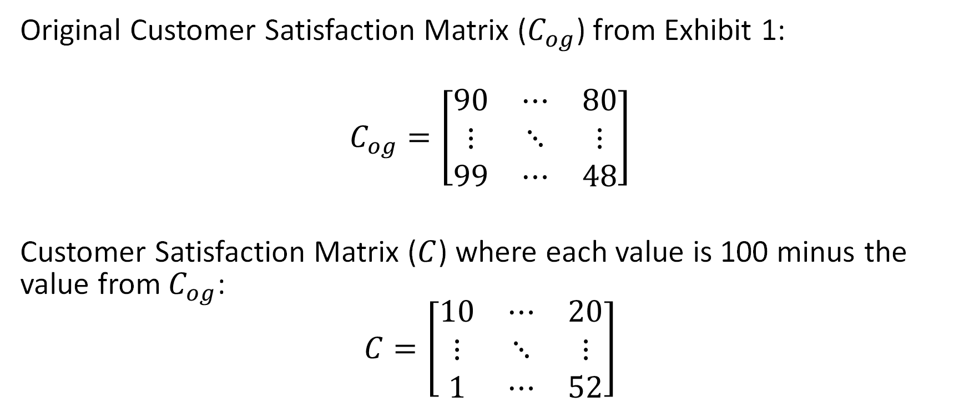
Data (Part 1)
Original Customer Satisfaction Matrix ($C_{og}$) from Exhibit 1:
$$C_{og}=\left[\begin{matrix}90 & ⋯ & 80 \\ ⋮ & ⋱ & ⋮ \\ 99 & ⋯ & 48\end{matrix}\right]$$
Customer Satisfaction Matrix ($C$) where each value is 100 minus the value from $C_{og}$:
$$C=\left[\begin{matrix}10 & ⋯ & 20 \\ ⋮ & ⋱ & ⋮ \\ 1 & ⋯ & 52\end{matrix}\right]$$

Slide 5
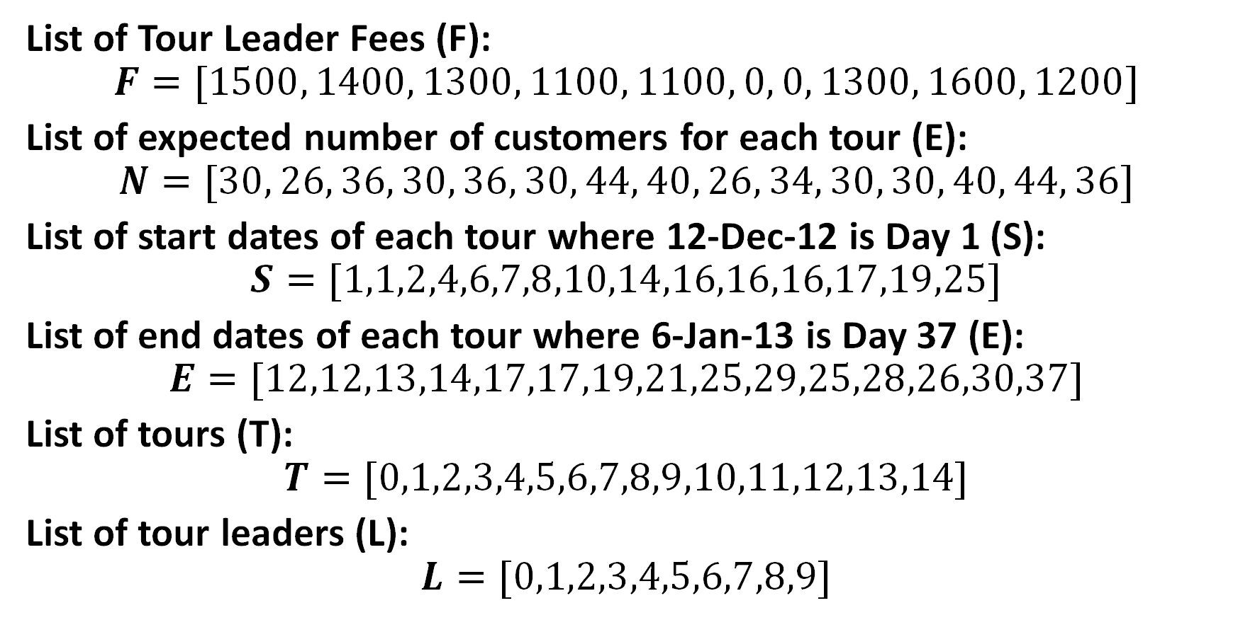
Data (Part 2)
List of Tour Leader Fees (F):
$$F=[1500, 1400, 1300, 1100, 1100, 0, 0, 1300, 1600, 1200]$$
List of expected number of customers for each tour (E):
$$N=[30, 26, 36, 30, 36, 30, 44, 40, 26, 34, 30, 30, 40, 44, 36]$$
List of start dates of each tour where 12-Dec-12 is Day 1 (S):
$$S=[1,1,2,4,6,7,8,10,14,16,16,16,17,19,25]$$
List of end dates of each tour where 6-Jan-13 is Day 37 (E):
$$E=[12,12,13,14,17,17,19,21,25,29,25,28,26,30,37]$$
List of tours (T):
$$T=[0,1,2,3,4,5,6,7,8,9,10,11,12,13,14]$$
List of tour leaders (L):
$$L=[0,1,2,3,4,5,6,7,8,9]$$

Slide 6

Decision Variables
$$x_{t,l}=\left\{\begin{aligned}1 if tour t∈T is lead by leader l∈L \\ 0 otherwise\end{aligned}\right.$$

Slide 7
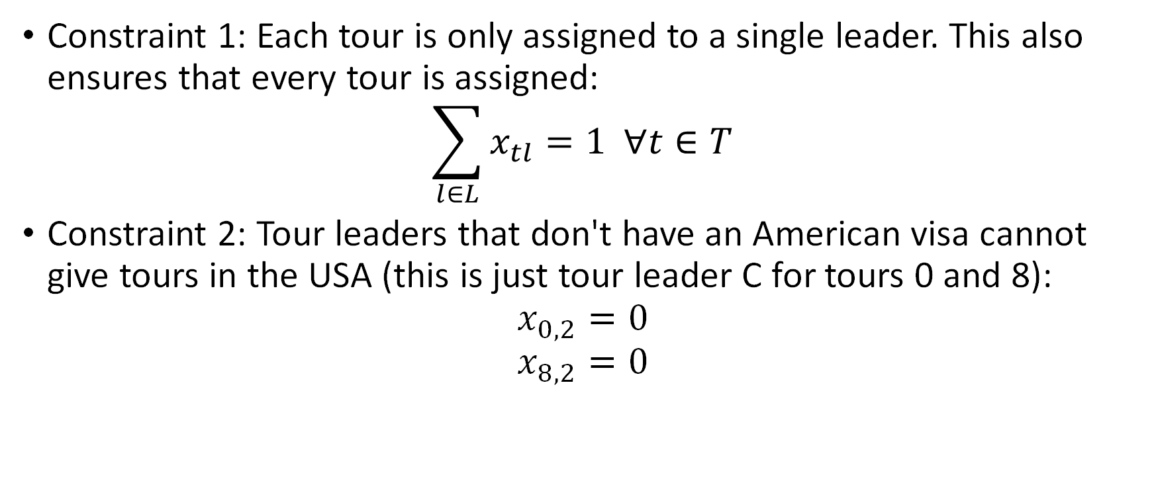
Constraints (Part 1)
Constraint 1: Each tour is only assigned to a single leader. This also ensures that every tour is assigned:
$$\sum_{l∈L}{x_{tl}}=1 ∀t∈T$$
Constraint 2: Tour leaders that don't have an American visa cannot give tours in the USA (this is just tour leader C for tours 0 and 8):
$$x_{0,2}=0$$
$$x_{8,2}=0$$

Slide 8
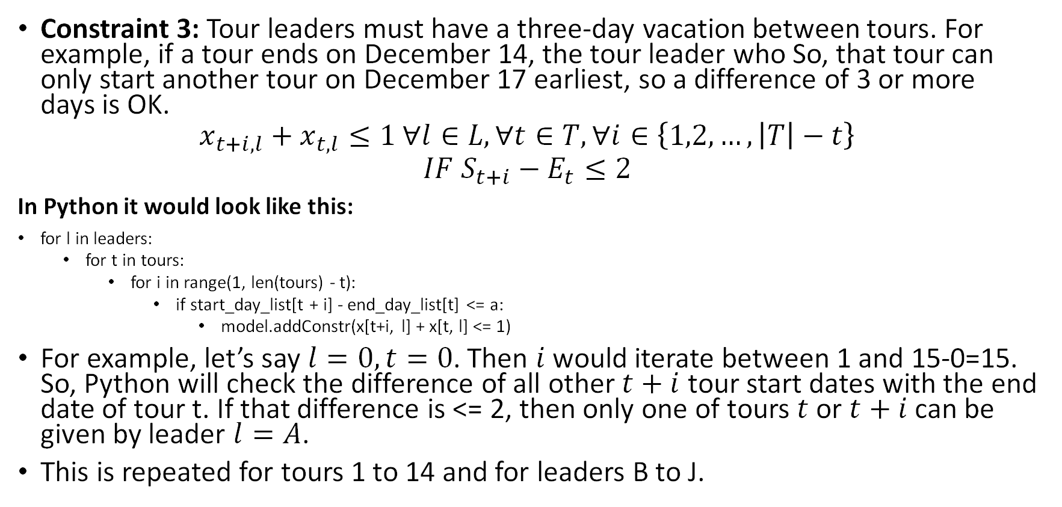
Constraints (Part 2)
Constraint 3: Tour leaders must have a three-day vacation between tours. For example, if a tour ends on December 14, the tour leader who So, that tour can only start another tour on December 17 earliest, so a difference of 3 or more days is OK.
$$x_{t+i,l}+x_{t,l}≤1 ∀l∈L, ∀t∈T, ∀i∈\left\{1,2,…, \left|T\right|−t\right\}$$
$$IF S_{t+i}−E_{t}≤2$$
In Python it would look like this:
for l in leaders:
for t in tours:
for i in range(1, len(tours) - t):
if start_day_list[t + i] - end_day_list[t] <= a:
model.addConstr(x[t+i, l] + x[t, l] <= 1)
For example, let’s say $l=0, t=0$. Then $i$ would iterate between 1 and 15-0=15. So, Python will check the difference of all other $t+i$ tour start dates with the end date of tour t. If that difference is <= 2, then only one of tours $t$ or $t+i$ can be given by leader $l=A$.
This is repeated for tours 1 to 14 and for leaders B to J.

Slide 9
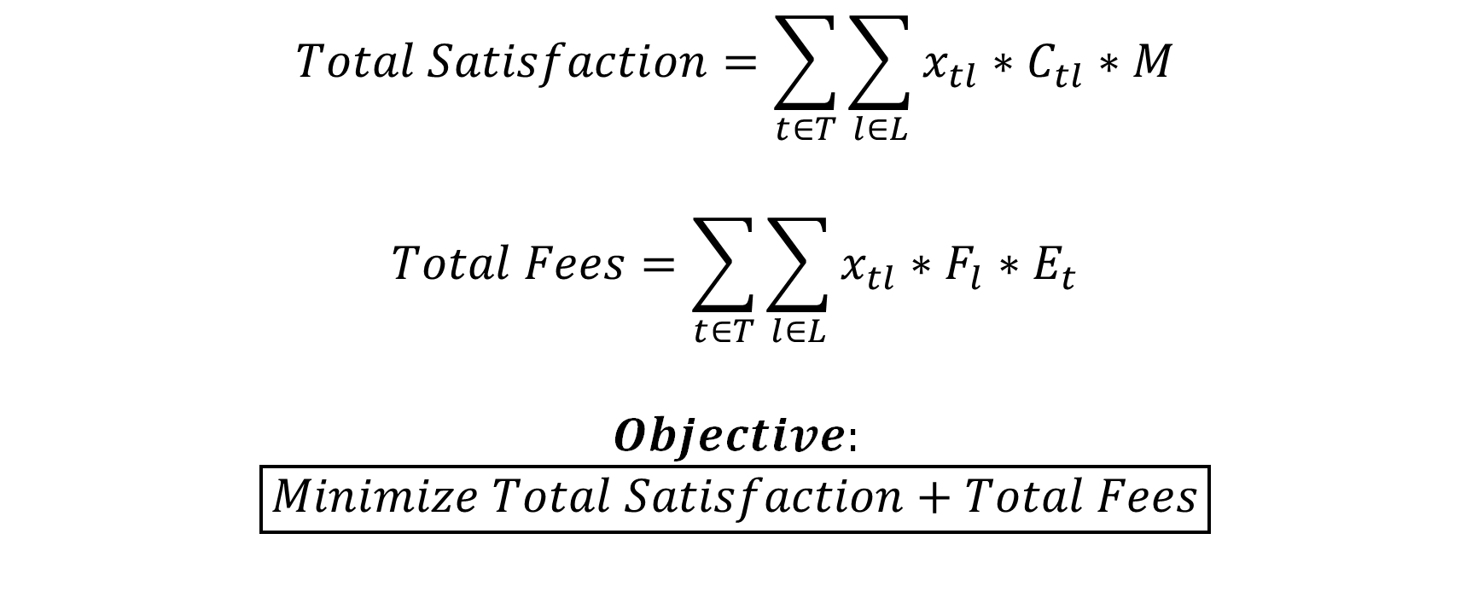
Objective Function
$$Total Satisfaction=\sum_{t∈T}{\sum_{l∈L}{x_{tl}}}∗C_{tl}∗M$$
$$Total Fees=\sum_{t∈T}{\sum_{l∈L}{x_{tl}∗F_{l}∗E_{t}}}$$
$$Objective:$$
$$\boxed{Minimize Total Satisfaction+Total Fees}$$

Slide 10
Find Optimal Weight For Satisfaction Score
The objective function has “M” multiplied by the satisfaction score. This is to scale the satisfaction score to the same level as the fees so that the model takes the task of minimizing the satisfaction scores as seriously as the fees. The sum of all satisfaction scores is in the scale of 100s while the total fee multiplied by the number of customers is in the scale of 100,000s.
Our goal: to find the minimum “M” that yields the largest minimum (maximin) satisfaction score across tours. The next slide will show the algorithm to how we achieved this.
The reason why we want the minimum “M” is because the higher the “M” is, the more the satisfaction score will be prioritized, and the fee will be compromised.
Therefore, we want the “M” to be just large enough that both the satisfaction score and the fee will be good.

Slide 11
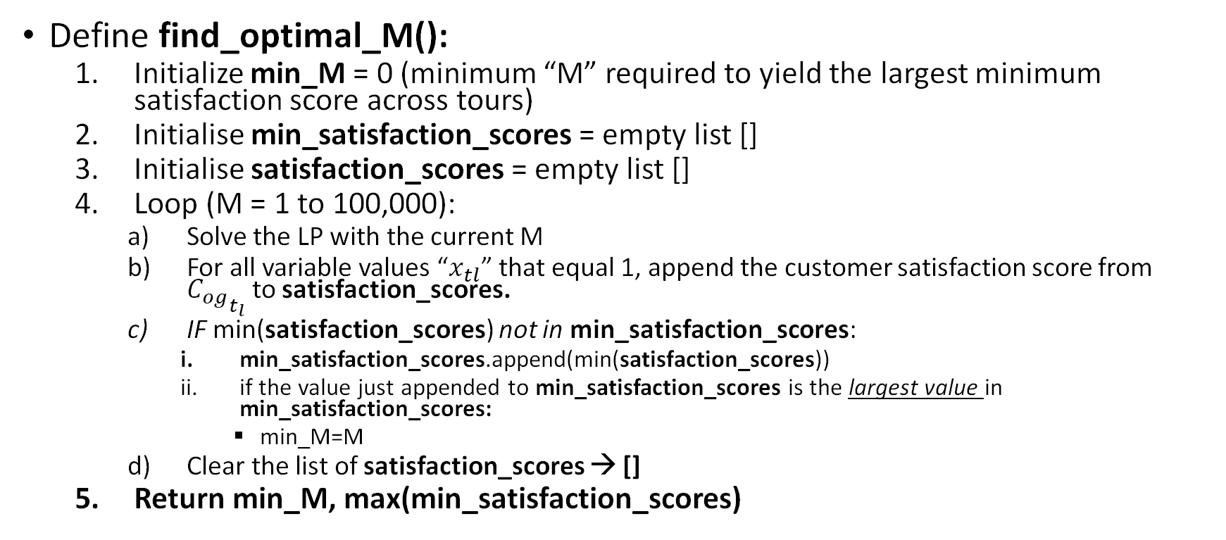
Find Optimal Weight For Satisfaction Score (Part 2) - pseudocode
Define find_optimal_M():
Initialize min_M = 0 (minimum “M” required to yield the largest minimum satisfaction score across tours)
Initialise min_satisfaction_scores = empty list []
Initialise satisfaction_scores = empty list []
Loop (M = 1 to 100,000):
Solve the LP with the current M
For all variable values “$x_{tl}$” that equal 1, append the customer satisfaction score from ${C_{og}}_{t_{l}}$ to satisfaction_scores.
IF min(satisfaction_scores) not in min_satisfaction_scores:
min_satisfaction_scores.append(min(satisfaction_scores))
if the value just appended to min_satisfaction_scores is the largest value in min_satisfaction_scores:
min_M=M
Clear the list of satisfaction_scores → []
Return min_M, max(min_satisfaction_scores)

Slide 12
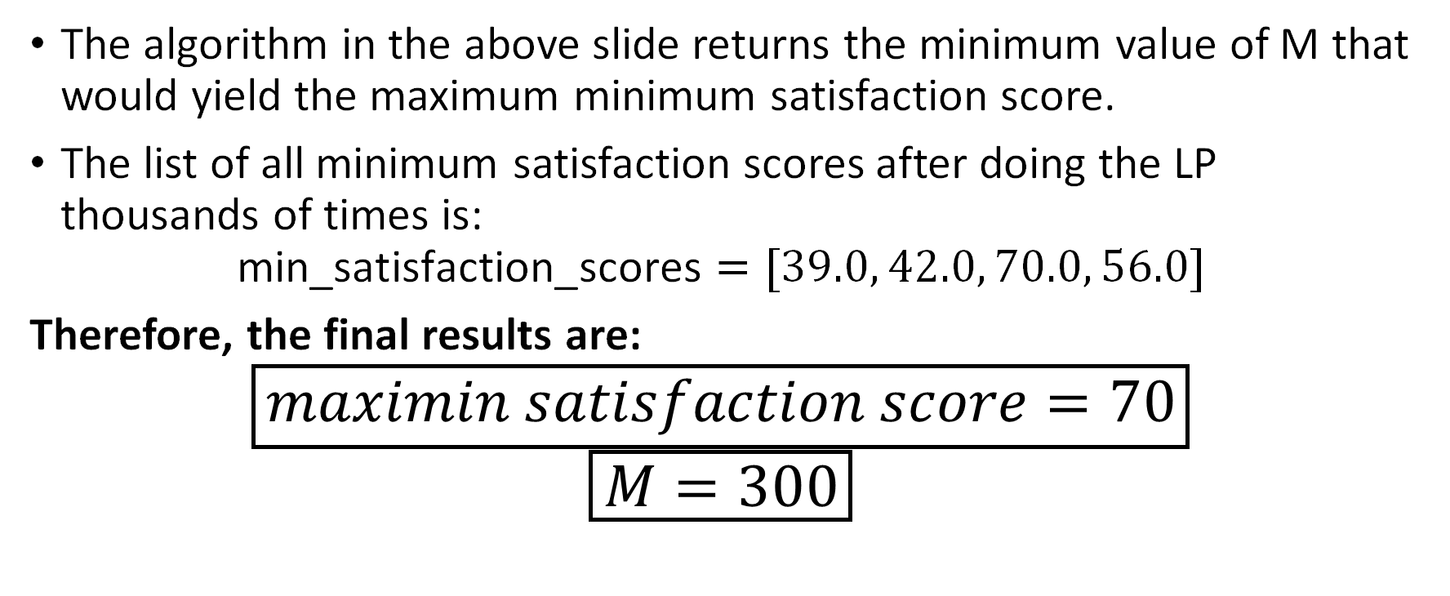
Find Optimal Weight For Satisfaction Score (Part 3)
The algorithm in the above slide returns the minimum value of M that would yield the maximum minimum satisfaction score.
The list of all minimum satisfaction scores after doing the LP thousands of times is:
$$\text{min}\text{_}\text{satisfaction}\text{_}\text{scores}=[39.0, 42.0, 70.0, 56.0]$$
Therefore, the final results are:
$$\boxed{maximin satisfaction score=70}$$
$$\boxed{M=300}$$

Slide 13
Results For Base Model (Part 1)
Tour | Leader | Leader Score | Tour Leader Cost | Num Customers | Start Day | End Day
1 | A | 90 | 1500 | 30 | 1 | 12
2 | E | 81 | 1100 | 26 | 1 | 12
3 | C | 91 | 1300 | 36 | 2 | 13
4 | F | 92 | 0 | 30 | 4 | 14
5 | I | 97 | 1600 | 36 | 6 | 17
6 | D | 76 | 1100 | 30 | 7 | 17
7 | G | 87 | 0 | 44 | 8 | 19
8 | B | 95 | 1400 | 40 | 10 | 21
9 | J | 80 | 1200 | 26 | 14 | 25
10 | H | 70 | 1300 | 34 | 16 | 29
11 | C | 90 | 1300 | 30 | 16 | 25
12 | A | 99 | 1500 | 30 | 16 | 28
13 | E | 83 | 1100 | 40 | 17 | 26
14 | F | 84 | 0 | 44 | 19 | 30
15 | G | 87 | 0 | 36 | 25 | 37

Slide 14
Results For Base Model (Part 2)
The total cost for all customers is $470,400
The total cost per customer for all tours is $14,400
The average customer score is 86.8%
The minimum customer score is 70%
The maximum customer score is 99%
The model effectively balances cost minimization and customer satisfaction so that a high average satisfaction score is achieved with minimal cost.

Slide 15
Results for Base Model (Part 3)
In the objective function, the total fee * expected number of customers is being minimized. Therefore, it should be expected that as the number of customers increases, the fee of individual leaders decreases since a large fee multiplied by a large number of customers would yield large numbers which is what the model is trying to avoid.
The correlation matrix below shows that indeed, tour leader cost is negatively correlated with the number of customers. This means that the more customers there are, the cheaper the fee of the leader that the model assigns to that tour so as to minimize the total cost that customers pay.
Correlation Matrix of Tour Leaders and E(# of Customers)
 | Tour Leader Cost | Expected Number of Customers
Tour Leader Cost | 1 | -0.412
Expected Number of Customers | -0.412 | 1

Slide 16
Sensitivity Analysis (Part 1)
Test how the results differ if the number of vacation days that leaders have between tours is changed. Currently, leaders have 2 days between tours.
It was found that 3 is the maximum number of vacation days between tours that make the problem feasible. If there were 4 or more days, there wouldn’t be enough tour leaders to be assigned to tours since they would all be on vacation.
Therefore, our search space for sensitivity analysis is 0,1, and 3 days. The results for 2 days are also included to compare with the base solution.

Slide 17
Sensitivity Analysis (Part 2)
Discussion of results:
Results are in the table below
The minimum satisfaction score only changes when the number of days is 3 which makes sense because more compromises will have to be made due to less tour guides being available.
However, overall, these results cannot really be compared with each other because M=300 is used in the objective function for all the vacation day numbers. Each one needs its own unique “M,” and this will be shown on the following slide.
Num Days | Minimum Satisfaction Score | Average Satisfaction Score | Total Fee
0 | 70 | 85.3 | $446,800
1 | 70 | 85.3 | $446,800
2 (Base) | 70 | 86.8 | $470,400
3 | 33 | 84.1 | $468,400

Slide 18
Sensitivity Analysis (Part 3)
This new table shows all the results that are in the table from the previous slide, however, now the optimal “M” is used for each number of days. So that there’s no need to switch to the previous slide, the values form the previous slide are in brackets.
As can be seen, with M optimized for each respective day, the satisfaction score is higher because it’s more prioritized. This is the best way to compare the differences between the number of days.
Neither the satisfaction score nor the cost would change if the number of days were 0 or 1. So if the directors of EU Holidays want to reduce vacation days, they should reduce them to 1 since 0 vacation days would not help the directors satisfy customers, and it would just make the tour guides angry that they have no vacation. (Plus, it wouldn’t give time to travel between countries).
Increasing the number of vacation days to 3 would not significantly increase the cost, however, it would significantly decrease the satisfaction score which might draw customers away.
It seems that when the number of vacation days = 2, the total fee is balanced out best with the satisfaction score. So, the base solution might be the best.
Num Days | M | Minimum Satisfaction Score | Average Satisfaction Score | Total Fee
0 | 700 | 80 (70) | 89.8 (85.3) | $477,000 ($446,800)
1 | 700 | 80 (70) | 89.8 (85.3) | $477,000 ($446,800)
2 (Base) | 300 | 70 (70) | 86.8 (86.8) | $470,400 ($470,400)
3 | 500 | 39 (33) | 84.7 (84.1) | $472,400 ($468,400)

Slide 19
Conclusion
The linear programming model effectively addresses EU Holidays' scheduling challenge, balancing tour leader costs and customer satisfaction.
Increasing the importance of customer satisfaction (higher M) improves satisfaction but increases cost, emphasizing a strategic balance. Our metric was that M should be increased to the minimum amount it would take for the minimum satisfaction score across all tours to be maximized. Of course, if you keep increasing M, the average satisfaction score will keep increasing (as we tested), however the fee will also increase – so we thought that the minimum satisfaction score was a reasonable metric.
The base scenario (2 days between tours, optimal weight M=300 achieved a total cost of $470,400 across all expected customers and an average customer satisfaction of 86.8%.
Sensitivity analysis highlights key trade-offs:
Reducing days between tours (0–1 days) improves satisfaction by 10% compared with 2 days, however, it increases total costs by $6,600.
Increasing the number of days to 3 causes both satisfaction and total costs to be worse.
Recommendation: Keep the 2-day gap between tours, as it balances high customer satisfaction with controlled costs pretty well plus it gives employees time to rest before their next tour.
As customer preferences and business objectives evolve, the weighting factor M should be continuously re-evaluated.

